Slide 1
TAMIL TEXT TO ENGLISH EMOTIONAL SPEECH WITH UNL FOR TRANSLATION
Siva M R
Archana B
Jayavasanth R
Guided by
Dr. Rajeswari Sridhar

Slide 2
EVALUATION OF THE SYSTEM

Slide 3
evaluation
For evaluating translation four measures namely, BLEU, NIST, METEOR and Fluency and Adequacy are employed.
Since Tamil does not have accurate sentence types, the evaluation is categorized based on the type of sentence (simple,compound or complex) of the reference text.

Slide 4
Bleu score
BLEU stands for Bilingual Evaluation Understudy.
It is a n-gram co-occurrence based MT evaluation system that verified how close the MT translated text is to , to a human translated reference. N-gram precision in BLEU is computed as follows:
Pn= ∑_{Cϵ{Candidates}}∑_{n−gramϵC}Count_{clip}(n−gram) ------------------------------------------------------------
_{Cϵ{Candidates}}∑_{n−gramϵC}Count(n−gram)
Where Count_{clip}(n − gram) is the maximum number of n-grams co-occurring in a candidate translation

Slide 5
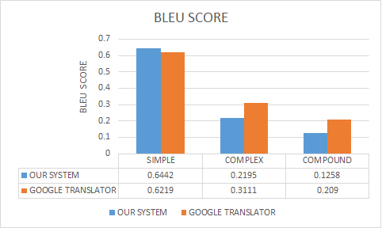
BLEU score comparison WITH GOOGLE TRANSLATOR

Slide 6
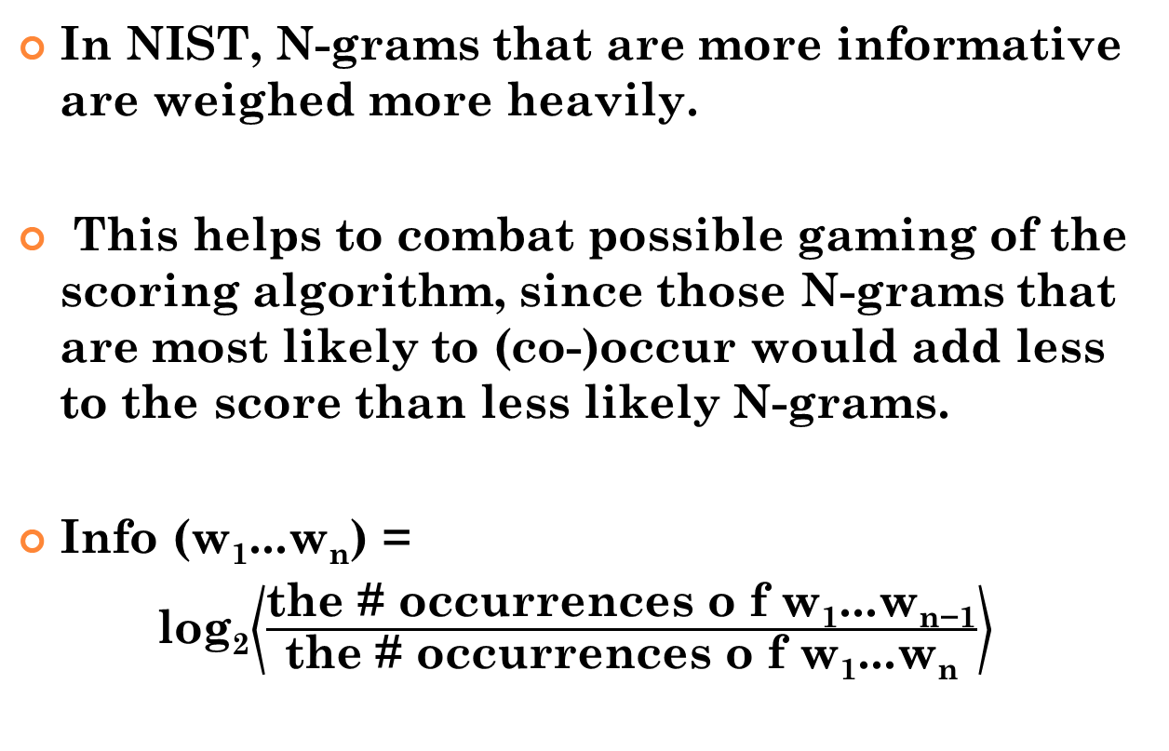
NIST evaluation
In NIST, N-grams that are more informative are weighed more heavily.
This helps to combat possible gaming of the scoring algorithm, since those N-grams that are most likely to (co-)occur would add less to the score than less likely N-grams.
Info (w₁...w_{n}) =
log₂$\left\langle \frac{\text{the}\text{ \# }\text{occurrences} \text{o} \text{f} \text{w}\text{1}\text{...}\text{wn}\text{−1}}{\text{the}\text{ \# }\text{occurrences} \text{o} \text{f} \text{w}\text{1}\text{...}\text{wn}}\right\rangle$

Slide 7
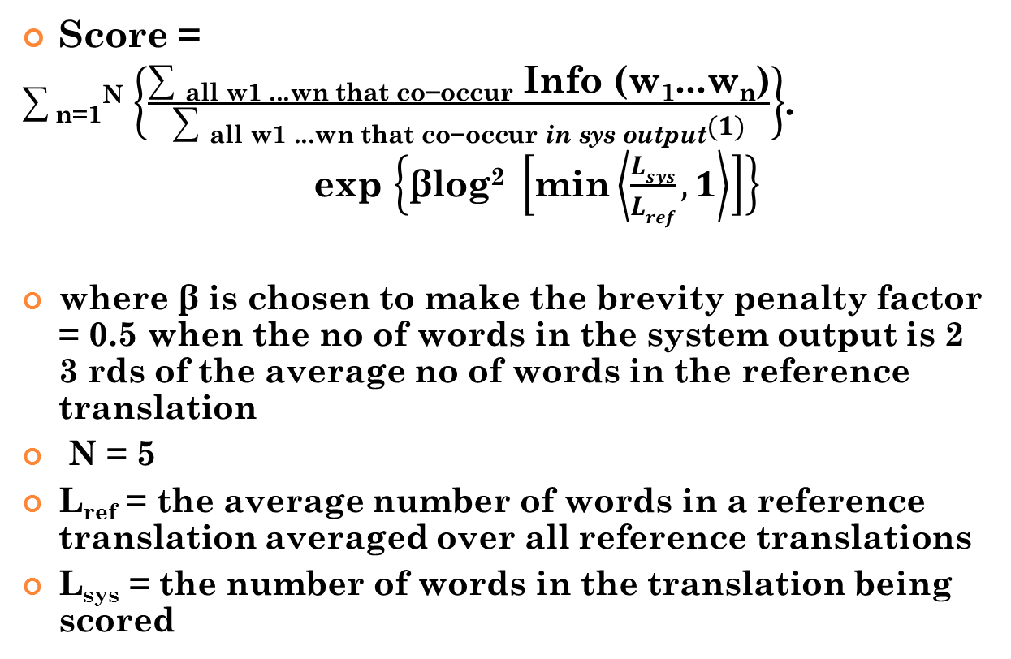
NIST EVALUATION
Score =
∑ _{n=1}^{N} $\left\{\frac{\text{∑ }\text{all} \text{w}\text{1 ...}\text{wn} \text{that} \text{co}\text{−}\text{occur} \text{Info}\text{ (}\text{w}\text{1}\text{...}\text{wn}\text{)}}{\text{∑ }\text{all} \text{w}\text{1 ...}\text{wn} \text{that} \text{co}\text{−}\text{occur} \text{in} \text{sys} \text{output}(1)}\right\}$.
exp $\left\{\text{β}\text{log}\text{2} \left[\text{min}\left\langle \frac{Lsys}{Lref},1\right\rangle \right]\right\}$
where β is chosen to make the brevity penalty factor = 0.5 when the no of words in the system output is 2 3 rds of the average no of words in the reference translation
N = 5
L_{ref} = the average number of words in a reference translation averaged over all reference translations
L_{sys} = the number of words in the translation being scored

Slide 8
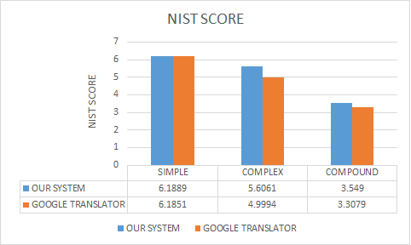
NIST score comparison with GOOGLE TRANSLATOR

Slide 9
METEOR EVALUATION
METEOR stands for Metric for Evaluation of Translation with Explicit ORdering.
It is based on the harmonic mean of unigram precision and recall , with recall weighted higher than precision.
It also has several features that are not found in other metrics, such as stemming and synonymy matching, along with the standard exact word matching.
Score is
M = F_{mean}(1− p)

Slide 10
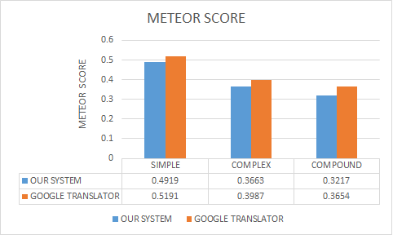
meteor score comparison with google TRANSLATOR

Slide 11
Fluency
Fluency is a measure of the grammatical correctness of the sentence.
Fluency score description
Score | Description
4 | perfectly correct sentence
3 | Minor tense/Noun-verb flaws , Understandable
2 | Major grammatical flaws , Understandable with effort
1 | 1 Sentence makes no sense

Slide 12
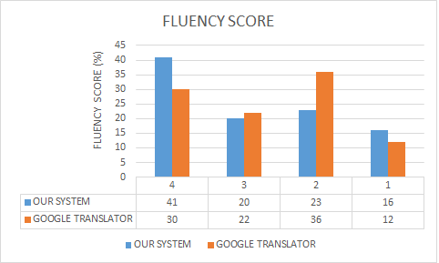
fluency score comparison with google TRANSLATOR

Slide 13
adequacy
Adequacy determines the degree of information conveyed by the translated text.
Score | Description
4 | Full meaning conveyed
3 | Most of the meaning conveyed
2 | Noun and/or Tense information conveyed
1 | No meaning at all

Slide 14
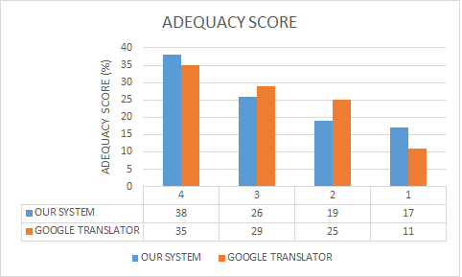
adequacy score comparison with google TRANSLATOR

Slide 15
Evaluation of emotional speech
A survey was conducted to determine how well emotion was expressed in the final prosodically enhanced output sentences.
Six recordings comprising of outputs expressing angry, happy and sad emotions were played and the corresponded responses were recorded

Slide 16
Survey Results on Identifying the Emotion present in Modified Voice
Emotion | Percentage of total responses that accurately identified the emotion from modified voice
Anger | 65%
Happiness | 57%
Sadness | 81%

Slide 17
Scores for Emotion present in the Modified Voice
Emotion | Average score for the identified emotion given by responder on a scale of 1-5
Anger | 3.6
Happiness | 3.2
Sadness | 4.1

Slide 18
CRITICISM
Most of the erroneous translations are attributed to the faults in POS Tagger.
POS Tags were assumed on words, on which no POS Tag could not be specified based on rules due to the non-availability of domain information and those words being void of any inflections.
This becomes much more difficult because of WSD - word sense disambiguation where the same word has multiple meanings based on its POS tag.

Slide 19
CRITICISM Contd.
The number of POS Tags was also limited to noun, verb, pronoun, adverb and adjective.
Exceptions also existed in Morphological analyser especially when there were named entities included as a part of the sentence.
Out of the 47 UNL relations 35 were handled by the UNL enconverter.

Slide 20
CONCLUSION
This system translates Tamil text to English text with UNL as interlingua and then voices the English text out with emotions.
The results of evaluation showed that UNL is indeed efficient in translation.
We have successfully added three emotions (sadness, happiness and anger) to the machine voice.

